Slide 1
CAR Review, 1Q, 2013
B Scala, J Carlisle, K Huang

Slide 2
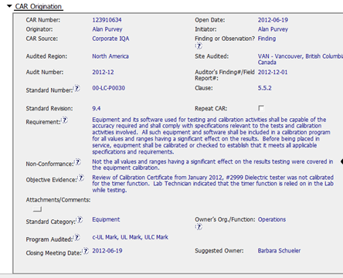
Why a finding when only 1 pc. Of equipment is cited in OE.
The NC does reflect the requirement.

Slide 3
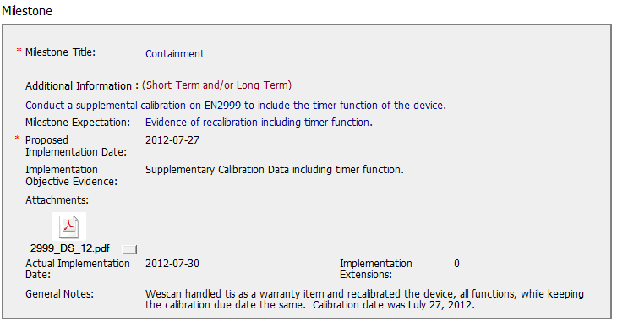
Good Containment milestone!

Slide 4
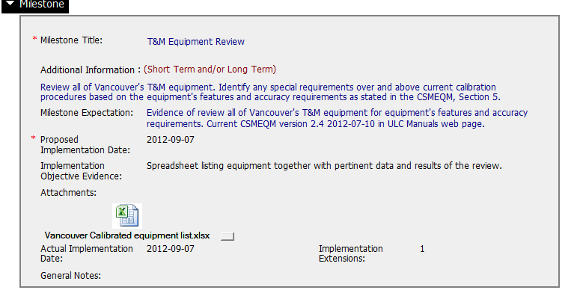
Good CA milestone regarding all equipment!!

Slide 5
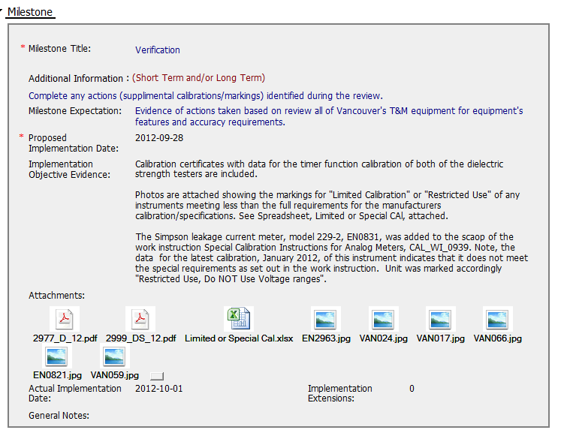
Excellent Verification milestone!! Good work!

Slide 6
Q1 2013 CAR Analysis
Team:
Bill Konigsfeld
Alan Purvey
Jenni Murrill

Slide 7
Q1 2013 CAR Analysis
Team:
Bill Konigsfeld
Alan Purvey
Jenni Murrill

Slide 8
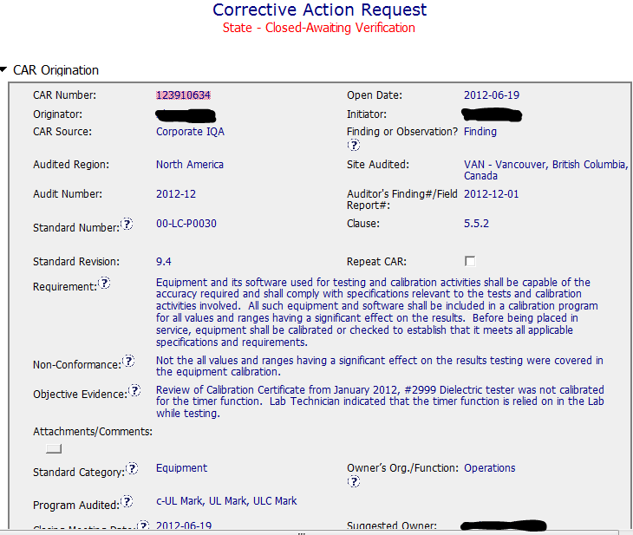
Finding: Good CAR
NCR: suitable information including identification of the cited unit is properly stated in the Requirement, NCR and Obj. Evidence sections.
Background

Slide 9
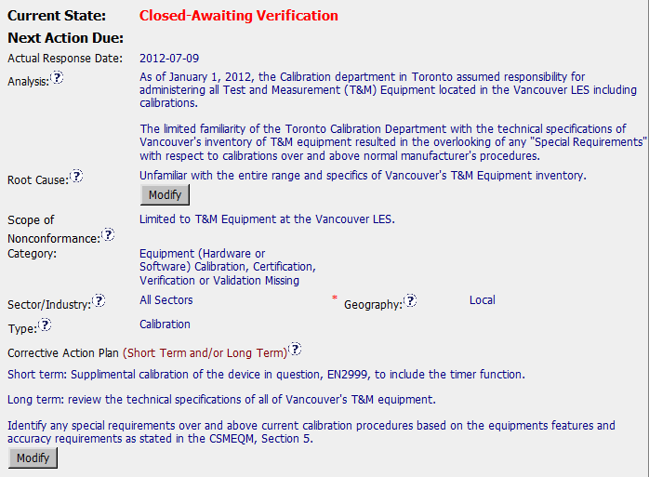
Finding: Good CAR
Analysis / Scope: audit limited issue to just the single site, unit in obj. evidence was sent to have the timer calibrated. No adjustment needed. No traceback required. Previous calibration included timer. Review of other equip. handled in milestone. Stakeholders - CAR Owner is also sole process Owner.
Owner
response
CAP: Milestones identified are appropriate. Unit sent out during audit. Other equip. reviewed in 2nd milestone.

Slide 10
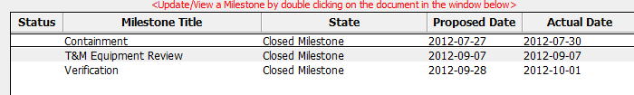
Finding: Good CAR
Milestones
Milestones: are appropriate. Unit sent out during audit for calib. Other equip. reviewed in 2nd milestone. Verification included data on the units identified in the 2nd milestone.
Recommendations for improvement: details known during the audit not present in the CAR & would assist in understanding. Doc History: request for addition as Opt. Recipient not implemented.

